Slide 1
Joseph Gravel MD, FAAFP
Professor & Chair, Medical College of Wisconsin
ADFM Annual Meeting – February 23,2024
(Acknowledgement: Mary Theobald,MBA)

Slide 2
STFM Antiracism Learning Collaborative

Slide 3
Learning Collaborative Highlights
September 2021-September 2023
Funded by Adtalem Global Education Foundation
Developed and led by STFM Antiracism Task Force
Evaluated by Robert Graham Center

Slide 4
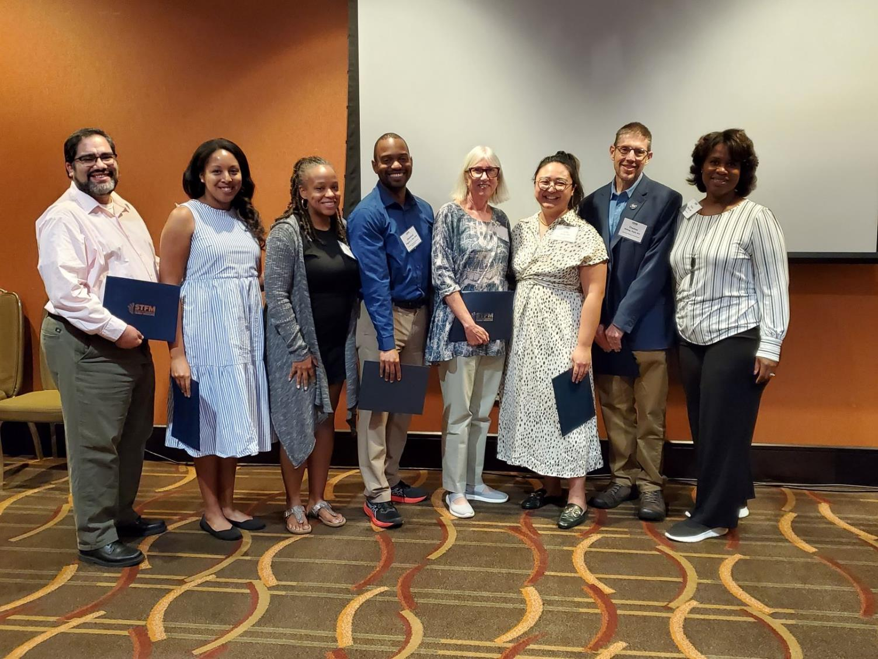
Cool things to know about what the task force has accomplished…
Notes:
This is most of the STFM Antiracism Task Force, which led the Antiracism Learning Collaborative. The Task Force was chaired by Tricia Elliott.

Slide 5
Learning Collaborative Goals
Empower and educate participants to identify racist structures and behaviors within their academic institutions and become leaders for change
Promote allyship
Spread effective change strategies

Slide 6
Who participated:
20 dyads from family medicine departments and residency programs:
Dyad =
1 URM
faculty member
+
1 ally
$185,808
Notes:
STFM received 57 applications for 20 available slots. Each application was reviewed and scored (based on a rubric) by two members of the STFM Antiracism Task Force. 20 dyads were selected. There was some turnover during the project, so analysis was done on 17 dyads that completed the full program.

Slide 7
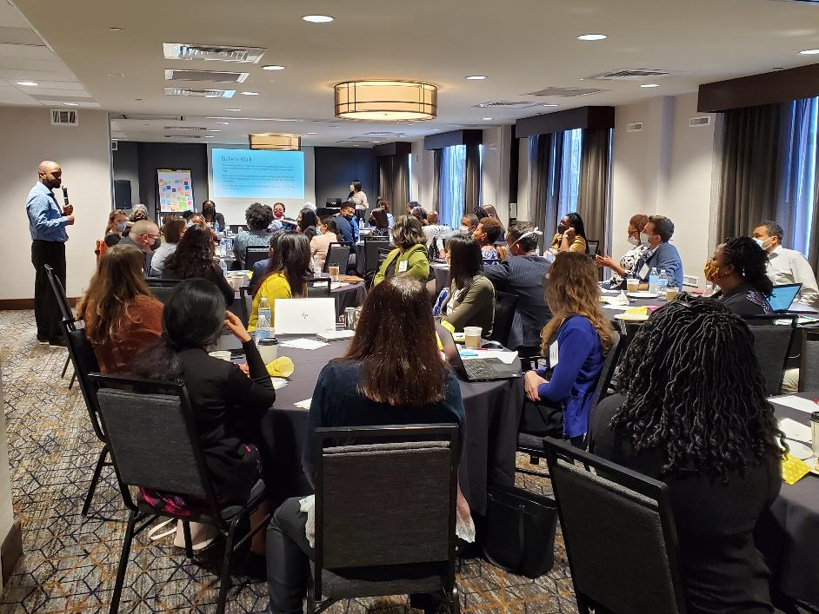
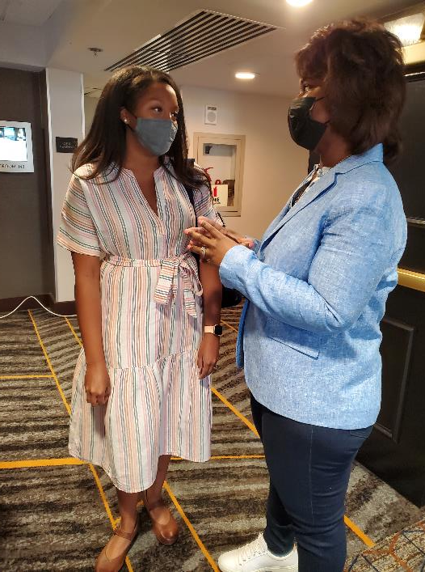
Notes:
Here are a few pictures of task force members and participants.

Slide 8
What participants did:
Attended virtual and in-person meetings
Created detailed plans for creating change within their institutions
Refined plans over time, worked on projects, tracked results
Completed surveys: pre-project, 7 months, 14 months, 20 months
Communicated regularly with mentors
Presented progress and challenges at the virtual sessions
Disseminated results at the final meeting and through poster presentations
$185,808
Notes:
Participants decided what their projects would be and how they wanted to implement them.

Slide 9
The results…

Slide 10
Confidence in skills to lead meaningful change within their institution
Survey | Mean Likert Scale Rating (0-10)
Baseline | 7.03
7-month | 5.97
14-month | 6.35
20-month | 7.06
Notes:
For each survey, participants were asked about confidence, i.e., “How confident are you in your skills to lead meaningful change within your institution?” Table 2 shows that the mean confidence rating declined at the 7-month survey, then it increased for the remaining surveys. An explanation for the change in ratings could be that the participants underestimated the effort in implementing their projects. They may have adjusted their rating as they gained experience, worked with their partner and/or mentor, or learned how to navigate their institutions’ structural limitations.

Slide 11
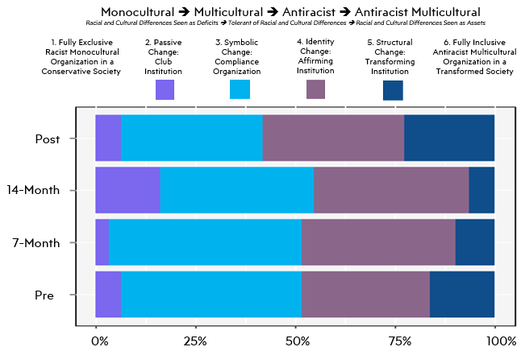
Where institution fell on Continuum on Becoming an Anti-Racist Multicultural Organization
Notes:
Participants were asked to “Review the Continuum on Becoming an Anti-Racist Multicultural Organization. Based on the descriptions, where would you rate your institution?” The goal was to move the dial, essentially, from the purple to the dark blue. The first survey results are at the bottom, and the end of project results at the top. Responses fluctuated over time. At the 14-month survey, participants rated their institutions lower on the continuum, compared to the 7-month and baseline surveys. In the post survey, participants rated their institutions higher. By the end of the Learning Collaborative, most projects would have been implemented or completed; the impact of the projects or the awareness that their projects brought to the institution, may have influenced their perception of their institution.

Slide 12
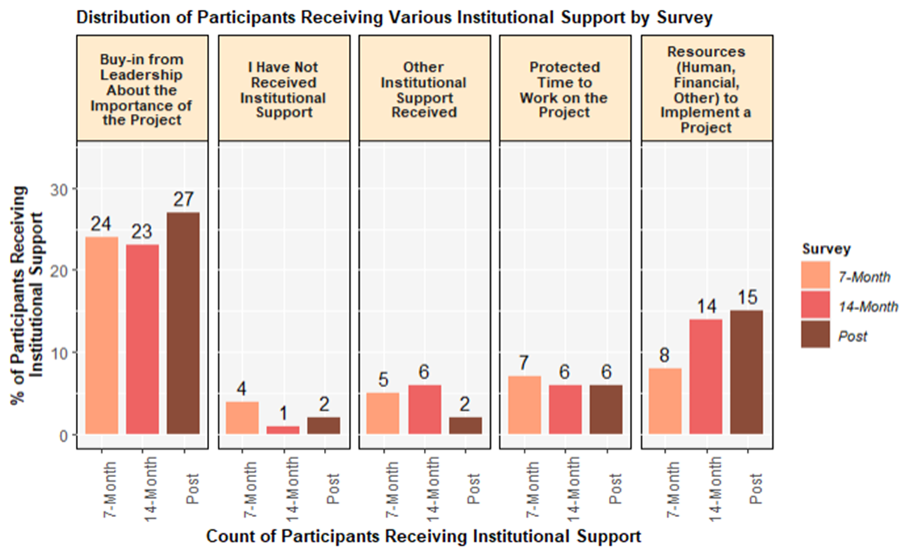
Institutional support credited for success
Notes:
Throughout the learning collabortive, participants were asked, “Which of the following institutional supports can you credit with any success you've had implementing your project?” The most common responses were buy-in from leadership and having resources – human, financial, and other to implement the project.

Slide 13
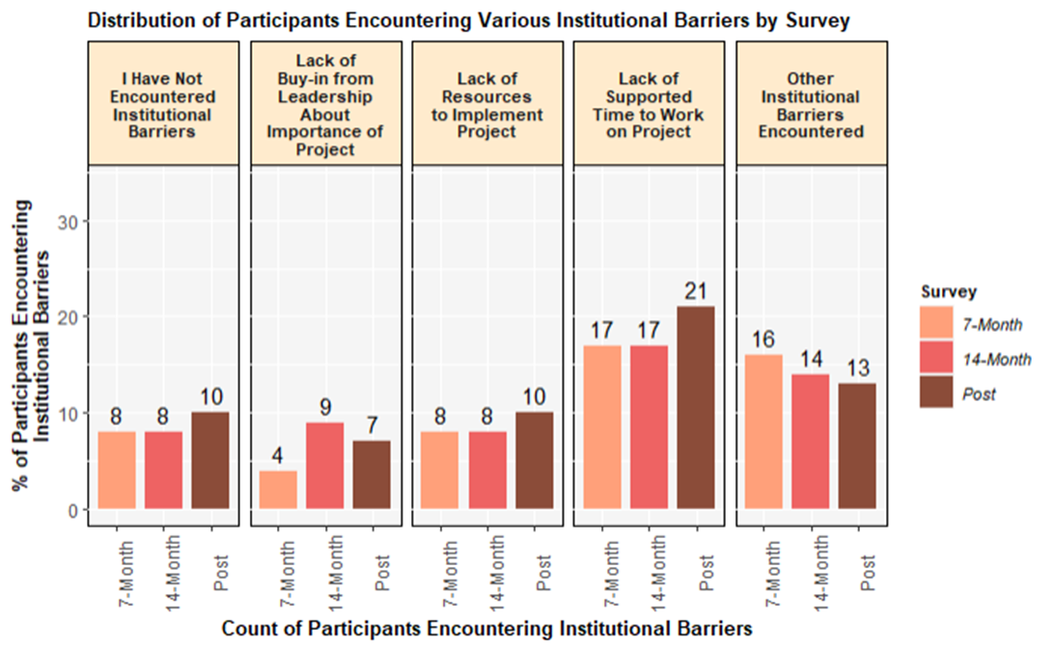
Institutional barriers
Notes:
And, related to that, “lack of supported time” was the most common answer to the question, “What institutional barriers have you encountered?”

Slide 14
Did the learning collaborative meet it’s goals?

Slide 15

Goal: Empower and educate participants to identify racist structures and behaviors within their academic institutions and become leaders for change
The training and resources, in addition to the practical experience of implementing projects to reduce racism, enhanced participants' ability to identify racist structures and behaviors within their academic institutions and become leaders for change.
38% of participants noted increased confidence in their skills to lead
meaningful change in their institution.
100% of participants believed they incorporated
strategies that led to positive outcomes when
implementing their projects.
This Photo by Unknown Author is licensed under CC BY-SA

Slide 16
Goal: Promote allyship
The learning collaborative promoted allyship in program activities and encouraged the use of allies in individual projects.
94% of participants said the ALC met its goal
to promote allyship.
This Photo by Unknown Author is licensed under CC BY-SA

Slide 17
Goal: Spread effective change strategies
Participants received faculty development on implementing change.
The learning collaborative provided participants opportunities to present their projects/findings.
Participants were encouraged to publish
and present their project results.
This Photo by Unknown Author is licensed under CC BY-SA

Slide 18
Lessons learned

Slide 19
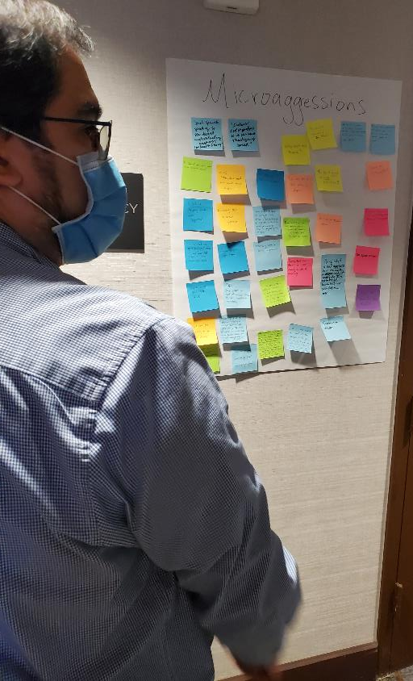
What worked well:
Dedicated staff
Leadership of task force
In-person meetings
Resources: Shared platform for
communication; subject matter experts
Agility
Dyad structure?
Mentors?
Notes:
The overall LC infrastructure was flexible in that it could respond to unforeseen needs. For example, the task force implemented office hours and unstructured virtual meeting space in response to participants asking for more touch points. As far as working in a dyad, overall, participants said they liked the structure because of pairing with others who were at a different career stage and who had other lived experience. But a couple of participants expressed difficulty in consistently meeting with their dyad partner due to parental leave or retirement.
Some participants described the benefits of meeting with their mentors, such as clarifying next steps, listening to needs and frustrations, and sharing experiences. A few participants indicated they were unsatisfied with the relationship, i.e., the mentor was not as helpful as they would have liked, or they had persistent scheduling challenges.

Slide 20
Future considerations:
Funding and strategies for protected time
More opportunities for collaboration, communication, and structured networking among dyads in between sessions
Increase the number of in-person sessions
Decrease program duration from 21 to 12 months.
Encourage mentees to prepare specific questions for their mentors to achieve better input
Notes:
These are areas identified to consider if STFM continues with the learning collaborative

Slide 21
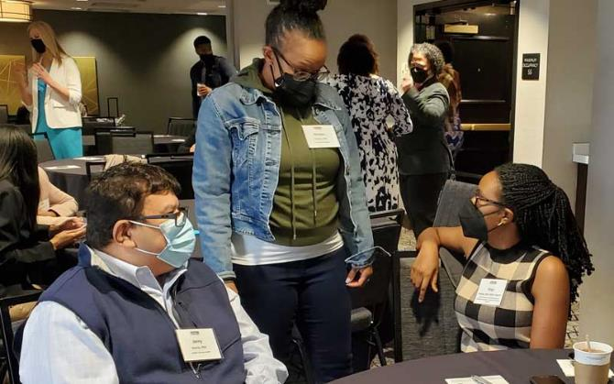
Future considerations:
Revisit mentor/mentee matching process
Encourage participants when developing their project proposals to incorporate existing initiatives or work with local programs
at their institution, i.e.,
a DEI office
Notes:
For example, instead of utilizing a top-down approach to match mentors to mentees, use a bottom-up approach, such as by providing mentees with a chance to question potential mentors before being matched.

Slide 22
Questions?

