Slide 1
Alphabet Soup: Who Are All of These Family Medicine Organizations

Slide 2

The Family Missions…(not including Foundations)
•American Academy of Family Physicians (AAFP): To improve the health of patients, families, and communities by serving the needs of members with professionalism and creativity
•American Board of Family Medicine (ABFM): To promote excellence in medical care through educational and scientific initiatives. Through certification and maintenance of certification programs, the ABFM pursues its mission by establishing, maintaining, and measuring high standards of excellence in the specialty of family medicine.
•Association of Departments of Family Medicine (ADFM): ADFM is the organization of departments of family medicine and is devoted to transforming care, education, and research to promote health equity and improve the health of the nation.

Slide 3
The Family Missions…(not including Foundations)
•Association of Family Medicine Residency Directors (AFMRD): To inspire and empower family medicine residency program directors to achieve excellence in family medicine residency training
•North American Primary Care Research Group (NAPCRG): To develop, disseminate, advocate for, and promote new knowledge regarding primary care
•Society of Teachers of Family Medicine (STFM): Advancing family medicine to improve health through a community of teachers and scholars

Slide 4
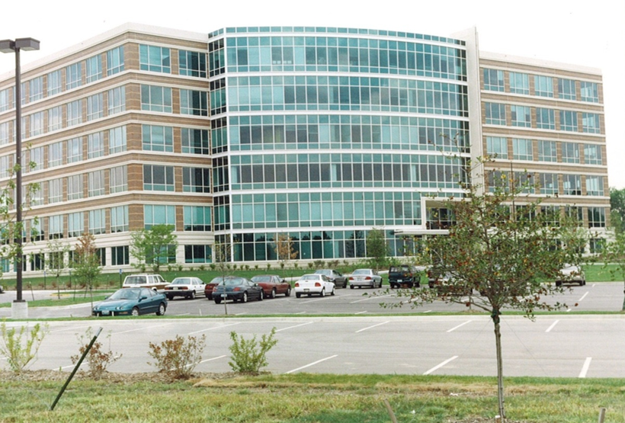
Where We All Reside
The building below at 11400 Tomahawk Creek Parkway in Leawood, KS is home to STFM, AAFP, AFMRD, ADFM, and NAPCRG.
The ABFM offices are in Lexington, KY.

Slide 5
Membership/
Diplomate Comparisons of Family Organizations
 | STFM | AAFP | ABFM | ADFM | AFMRD | NAPCRG
FM Faculty | X | X | X | Administrators | Associate Program Directors | X
Dept Chairs | X | X | X | X |  | X
Program Directors | X | X | X |  | X | X
Pract Physicians | Minimal | X | X |  |  | Minimal
Behav Scientists | X |  |  |  |  | X
Researchers | X | X | X | Chairs who do rsch | Minimal | X
Fellows | X | X | X |  |  | X
Residents | X | X |  |  |  | X
Students | X | X |  |  |  | X
Total # Members/ Diplomates | 5043 | 133,500 | 97,000 | 272 | 695 | 1325
Notes:
Top row lists organizations. First column lists key audiences. Caveat that most of you in this room will spend a portion of your time seeing patients. Practicing physician means someone whose primary role is patient care and may only be involved in teaching as a volunteer preceptor.

Slide 6
Comparison of Top Common Priorities of the Family Medicine Organizations
 | STFM | AAFP | ABFM | ADFM | AFMRD | NAPCRG
Advocacy | X | X | X | X | X | X
Faculty/Prof. Development | X | X | X | X | X | X
Practice Enhancement | Through scholarship | X |  | Through HC delivery transformation | X | X
Scholarship/ Research | X | X | X | X | X | X
Health of the Public | Through education | X | X | Through education transformation | Through better residencies | Through new knowledge
Residency Innovation | X | X | X | X | X | X
Community Building | X | X |  | X | X | X
Workforce Development | X | X | X | Through education of all students; FMIGs | X | Through research capacity building
Notes:
Advocacy is a relatively new priority for ABFM. Won’t be involved in lobbying but definitely have an interest in shaping policy related to workforce and quality.

Slide 7
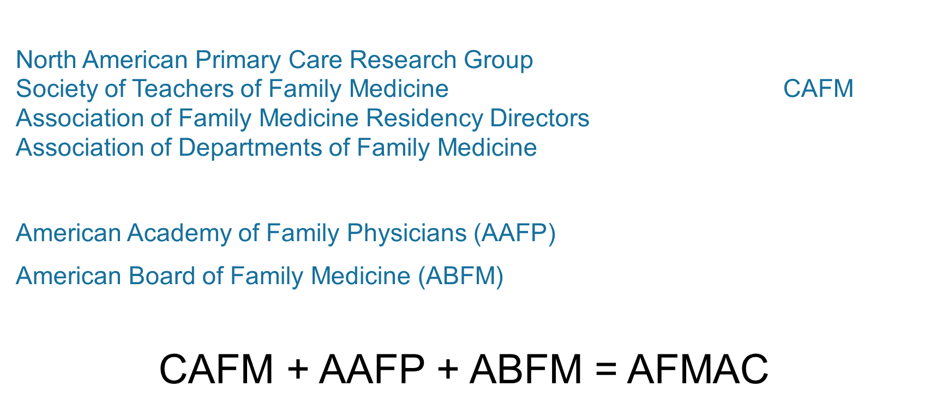
How does the Family work together?

Slide 8
ADVOCACY
Academic Family Medicine Advocacy Cmt (AFMAC)
(AAFP, ABFM, ADFM, AFMRD, STFM, NAPCRG)
AFMAC Legislative Priorities
  Medicare GME - general GME reform, Teaching Health Centers
  Workforce - residency positions, expansions, funding
  Title VII - appropriations, reauthorization, grant guidance
  Health Care Reform - implementation of key CAFM issues
  Primary Care Research Funding - develop a federal funding stream for FM through the Patient-centered Outcomes Research Institute (PCORI)
We work toward joint agreement on legislative policies related to academic family medicine.
Notes:
Discuss how we operate jointly for legislative policies related to academic FM. Imagine how we would look to Hill staff if we were lobbying for the same things but had different stances? Not very effective. ABFM just joined AFMAC.
AAFP has its own legislative priorities beyond academic issues – payment reform, RUC, FamMedPac

Slide 9
CAFM & FMLC
Council of Academic Family Medicine
  Strategy for academic family medicine to work together without consolidation
  Key initiatives: RC-FM responses, AAMC relationship building, FM Clerkship Curriculum, Leadership development
  CAFM Educational Research Alliance (CERA)
Family Medicine Leadership Consortium
  A meeting twice a year by leaders in the family to discuss issues of common interest and concern
  Keystone conferences, Future of Family Medicine project, Family Medicine for America’s Health

Slide 10
ADFM Advocacy - Working Together
ADFM supports the CAFM Washington office; Nina DeJonghe is Director of Government Relations, representing ADFM and the other CAFM organizations on key academic family medicine issues.
ADFM supports our departments to help them develop their advocacy efforts and skills in this area.
Works as part of AFMAC to develop unified family medicine policy on key academic family medicine issues.

Slide 11
Other Collaborative Efforts
Family Medicine for America’s Health
  Cosponsored by STFM, AAFP, AAFP Foundation, ABFM, ADFM, AFMRD, NAPCRG, and the American College of Osteopathic Family Physicians
  5-year initiative (ended May 2019) to drive continued improvement of the US health care system and demonstrate the value of true primary care.
Annals of Family Medicine
  Cosponsored by STFM, AAFP, ABFM, ADFM, AFMRD, NAPCRG, and the College of FP of Canada

