Slide 1
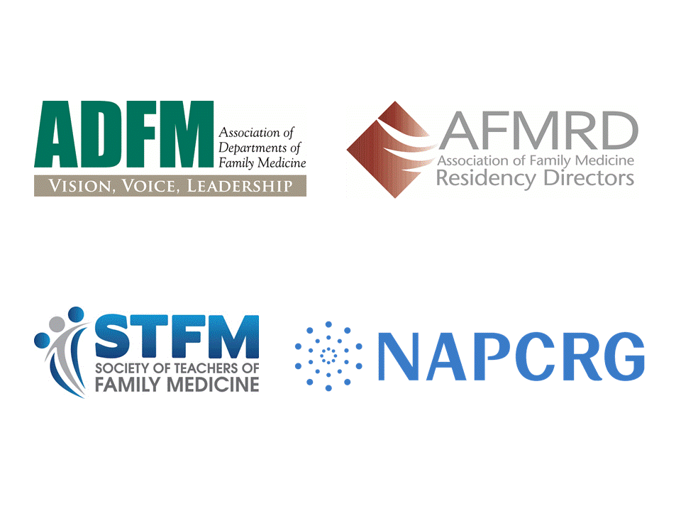
Hope Wittenberg
Director
Government Relations
August 14, 2019

Slide 2

Board of Directors
Executive Committee
Taskforces (PRN)
Operational Committees
Strategic Committees
Administrators’ Steering Committee
Finance Committee
Annual Conference Planning Committee
Leadership Development Committee
Education Transformation Committee
Research Development Committee
Nominations Committee
Membership Committee
Healthcare Delivery Transformation Committee
Diversity, Inclusion, & Health Equity Committee
Advocacy
Committee

Slide 3
How Does Organized Family Medicine Work Together?
North American Primary Care Research Group
Society of Teachers of Family Medicine CAFM
Association of Family Medicine Residency Directors
Association of Departments of Family Medicine
American Academy of Family Physicians (AAFP)
American Board of Family Medicine (ABFM)
CAFM + AAFP + ABFM = AFMAC

Slide 4
Academic Family Medicine Advocacy Committee - AFMAC
STFM
AFMRD
ADFM
NAPCRG
AAFP
ABFM
Notes:
After this slide Mary turns the call over to Tricia for the next set of slides

Slide 5
Academic Family Medicine Issues
Workforce:
  Medicare Graduate Medical Education
  Teaching Health Center Graduate medical education
  Veterans Administration graduate medical education
Title VII primary care training and enhancement grants
Rural residency development grant program
Research: Emphasis on Primary Care Research
  Agency for Healthcare Research and Quality (AHRQ)
  Some other research agencies; NIH, PCORI, CDC
hwittenberg@stfm.org
Notes:
Our main goal with these issues is twofold – 1) ensure the country produces enough family physicians, and 2) support primary care research to provide those physicians with the research outcomes they need to answer the clinical questions they see everyday in practice. Although it sounds self-serving, data show that a robust primary care structure within our nation’s health care system produces higher quality care at less cost.
Let me give you two examples of how this works. The first is the Affordable Care Act. Most view that act as major reform of health insurance and access for the nation – which of course it is. But that huge bill, or act, included multiple provisions on many issues, including reauthorization of certain programs that included changes, and establishment of new programs. I worked on the changes to the Title VII reauthorization. This is a set of programs that provides grants to departments of medical schools and residency programs to help develop curricula, set up projects related to education/training, etc. We worked on new priorities for grantees, new areas of interest for applicants to develop their proposals to address, and increased funding levels (authorization, not appropriations.) Also, very involved in the establishment of a new program – Teaching Health Center Graduate Medical Education. This program is strictly for the establishment or expansion of primary care residency training programs – to support increased production of primary care physicians in the community, rather than in large hospital systems. Unfortunately, at the last minute we were unable to get it funded by the Centers for Medicare and Medicaid Services (CMS), with Medicare entitlement funding – due to opposition from American Association of Medical Colleges (AAMC) and CMS itself, so it is housed in the Health Resources and Services Administration (HRSA) and must be reauthorized frequently. But this has been an extremely successful program – with new training programs in urban and rural areas.
My second example is our efforts to get more support for primary care research. It shows how long an advocacy campaign can take, just to get some funding for a specific item. AHRQ has authority to have a Center for Primary Care Research, but there is no dedicated funding for it. We started our efforts to gain a study of primary care research, funded by AHRQ, conducted by Rand Corporation.. That was a first step which showed the results we hoped for – that there is not much funding devoted to it, and there needs to be more, as well as a hub to coordinate such research… NIH, CDC, no place really does this work except AHRQ. As the study came out, this summer, we produced a webinar in September for Hill staff, discussing the importance of primary care research and the need for more funding. This will be a continuing effort in the next session of Congress, and perhaps more. Definitely a multi-year effort.
I hope this presentation has given you a glimpse into how STFM and other FM academic organization work to develop policy and advocate for our issues. I couldn’t cover much in such a brief time, and I’m sorry I can’t answer any questions, as this is just a recording, but if you have any questions, feel free to email me at Hwittenberg@stfm.org.

Slide 6
Appendix A – AFMAC Charter
(DRAFT)
2020-2021 AFMAC Priorities AFMAC’s Advocacy Priorities
(from AFMAC Charter, Appendix A –Proposed November, 2014, Adopted, February 2015; Reviewed with no changes 2016, small wording changes 2017; Reviewed and
adopted changes 2018); Reviewed 2020, major format and other changes to priorities:
Active AFMAC Advocacy (Includes both federal legislative and regulatory issues) Workforce:
PRE-MEDICAL
  Tier 2: Several Title VII pipeline programs (e.g. AHECs, HCOP)
UME
  Tier 1: Supervision of medical students (e.g. student documentation)
  Tier 2: Student loan programs (usually under the Education Department)
  Tier 2: Multiple Title VII programs (top priority within Title VII remains primary care training and enhancement program)
GME
  Tier 1: Federal GME funding sources, including CMS (mainly Medicare, but including Medicaid if major changes occur), HRSA (e.g. THCGME, rural residency development)
  Tier 1: Supervision (teaching physician) issues related to federal GME funding resources (primary care exception, remote precepting, telehealth by residents, etc.)
  Tier 2: Veterans Administration
  Tier 2: Title VII, primary care training and enhancement (includes residency as well as UME/faculty development/department funding)
Research:
Tier 1: Developing federal funding streams and a home for FM Research
Examples of Issues for which AAFP (or another organization) is taking the lead (Coalition Advocacy)
Healthcare Coverage for All
Investment in primary care/ pandemic-related practice assistance
Payment reform (value-based payment, alternative payment models, Medicare/Medicaid parity, etc.)
Practice transformation (administrative simplification, Direct Primary Care, health care delivery etc.)
Promotion of public health

