Slide 1
“Effective Recruitment of Minorities into Research”
Presenters:
Peter H. Seidenberg, MD, MA
Professor and Chair
Department of Family Medicine
LSU Health School of Medicine
Mark S. Johnson, MD MPH
Professor and Chair
Department of Community and Family Medicine
Howard University
Hot Topic Discussion
September 25, 2020

Slide 2
Peter Seidenberg’s Disclosures
None

Slide 3
Why Is Recruitment of Minorities Important?
Internal vs. External Validity
Funding sources often require minority representation
Healthcare disparities

Slide 4
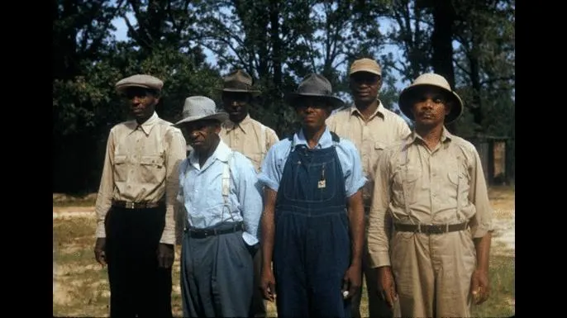
Why are Minorities Underrepresented in Study Populations?
Distrust of research
  Tuskegee Syphilis Study
    1932-1972
    399 men
  Studies on prisoners
    Guatemala - STIs
    Joilet, IL - Malaria
    Philadelphia, PA – viral hepatitis
    Columbus, OH – cancer cells
Role of healthcare disparities??
National Archives

Slide 5
Protections in Place for Research Subjects
1947 - Nuremberg Code
1964 - Declaration of Helinski
1966 - Office for Protection of Research Subjects (NIH)
  IRBs
1974 - National Research Act → National Commission for the Protection of Human Subjects
1979 – HHS → Ethical Principles and Guidelines for the Protection of Human Subjects of Research

Slide 6
Mark Johnson’s Disclosures
None

Slide 7
Successful recruitment begins with planning

Slide 8
There is no research without subjects

Slide 9
NIH requires minority recruitment. If not, justification is required

Slide 10
Early planning
Have a target
Target should be considered for sample size
Literature review should include epidemiologic reasons why outcomes might be different in women or minorities
Have members of the target groups involved with the research team early
  Community members and organizations
  clinicians

Slide 11
Budget considerations
Do not underbudget recruitment (if you build it they might not come)
Do prescreening to determine how many people need to be contacted to yield one research subject
Consider that the dropout rate may be higher with low income persons
Consider barriers to participation that affect low income persons
  Child care
  Inability to take off from work
  Transportation
  Parking

Slide 12
Who is on your team?

Slide 13
Have a communication plan
How will you reach out?
What is the target reading level of written material?
To what extent will the media be used?
Provide diverse pictures in all media
Give ongoing reports to all targeted constituencies

Slide 14
If there are not a lot of minorities in your community consider a multisite plan

Slide 15
Thank you

