Slide 1



INTEGRATED BEHAVIORAL HEALTH IN PRIMARY CARE
March 28, 2019
Ronald B. Margolis, PhD
Founder and CEO of Saint Louis Behavioral Medicine Institute
Professor Emeritus of the Department of Family and Community Medicine, St. Louis University School of Medicine
Dawn Prentice, LCSW
Director of Integrated Care and Health Psychology
St. Louis Behavioral Medicine Institute

Slide 2
Integrated Care Projects
Sidney R. Baer, Jr. Foundation
Greater St. Louis Health Foundation
2009-2010
Crider Health Center
2004 – 2009
2008 – 2009
Regional Health Commission
2013-2014 - St. Louis County Department of Health
2012-2014 - Betty Jean Kerr People’s Health Centers
Missouri Primary Care Integration Initiative
2008-2019
MPCA Chronic Pain Initiative
2016-2018

Slide 3
Missouri Primary Care
Health Home Initiative
Summary Report Jan 2012- July 2013
  Preliminary Data/Outcomes
    Reduction in A1C, LDL, Systolic & Diastolic Blood Pressure among enrolled patients
    5.86% Reduction in Hospital Admissions
    9.66% Reduction in ER use
    Total Medicaid savings of $2M

Slide 4
Preparing Future Family Medicine Physicians for Changing
Healthcare Environments
Integrated Care Models
  Co-located vs. Integrated
Mental Health
Team Care

Slide 5
Healthcare Environment
Reimbursement drives clinical practice
Models are changing
Acute Care to Chronic Care Model
Shortage of Primary Care Providers
Retention challenges of PCPs
Current practice model has limitations to increasing patient volume

Slide 6
U.S. Health Care System
Primary Care is de facto Mental Health System
  50-80% of Psychotropic medications are prescribed in Primary Care setting
Significant failure to detect and treat mental health disorders in Primary Care
  50% to 75% of patients who present with mental health disorders do not receive treatment for their disorders in Primary Care.
  25% of patients referred to specialty care are actually seen for initial appointments.

Slide 7
Access of Psychiatry Services:
A National Crisis
60% of Psychiatrists are 55+
12% growth in number of psychiatrists in the U.S. between 1995-2013
Fewer medical students choosing Psychiatry
ACA increasing eligibility for mental health services

Slide 8
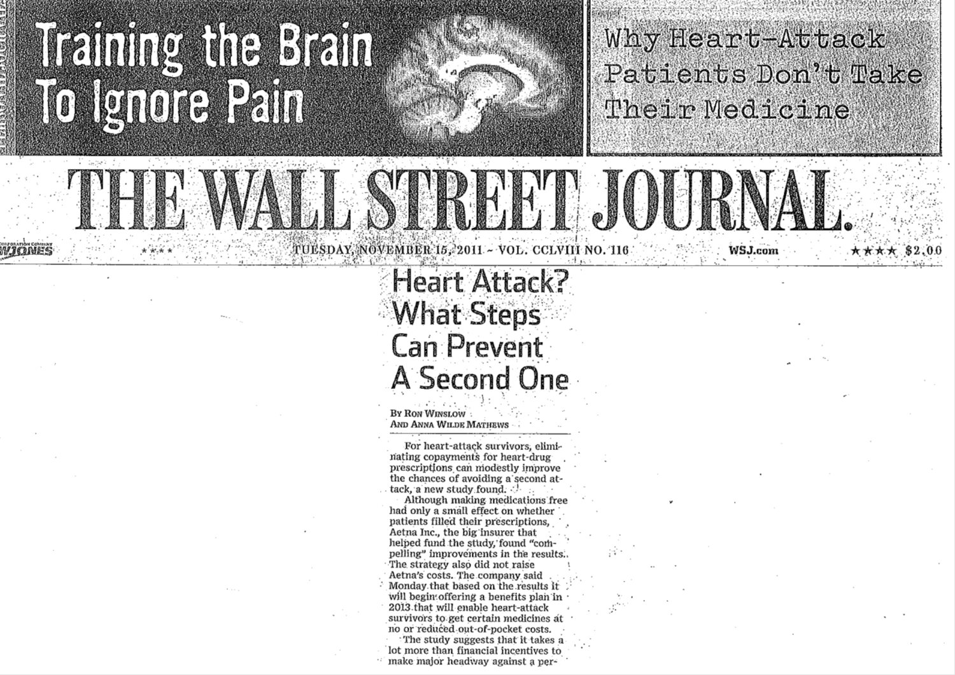
Medication Adherence Study:
Full Coverage for Preventive Medications after Myocardial Infarction
.
Choudhry, NK, et al. New England Journal of Medicine 2011; DOI: 10.1056/NEJMsa1107913

Slide 10

The Change is Now: Moving from Volume to Value
MACRA
The Medicare Access and CHIP Reauthorization Act of 2015
  a new approach to Medicare physician payment
The Merit-Based Incentive Payment System (MIPS) | The Advanced Alternative Payment Model (APM)
Administers bonuses or penalties based on performance on quality measures relative to other physicians. | Advanced APMs are defined as (i) measuring physicians and other providers according to metrics similar to those of MIPS, (ii) requiring providers’ use of certified EHRs, and (iii) holding providers accountable for at least “nominal financial risk.”
Patel, K., Adler, L., Darling, M., Ginsburg, P., Lieberman, S. (July 12, 2016) How Money Flows under MACRA. Retrieved from http://www.brookings.edu/research/papers/2016/07/12-how-the-money-flows-under-macra-patel-adler-darling-ginsburg

Slide 11
Key Factors in the Future
“Reforms” of the Affordable Care Law
Medicaid Expansion
Regulatory Agencies
Utilization of the Health and Behavior Codes

Slide 12
Key Factors in the Future
Medical/Healthcare Homes
How is “Value” delivered
Who can deliver Integrated Care
Reimbursement Impact on models of Integrated Care

Slide 13
Key Factors in the Future
Process/Outcome Research for Continuous Improvement
Support PCPs training in Mental Health/Psychopharmacology
Train Psychiatrists in a population based model

Slide 14
Thomas Kuhn:
The Structure of Scientific Revolutions
Paradigm change is a function of sociology, enthusiasm, and scientific promise. Not a logically determinant procedure.

Slide 15

It’s not so much that we are afraid of change or so in love with the old ways, but it’s the place in between we fear.. It’s like being between trapezes. It’s Linus when his blanket is in the dryer. There’s nothing to hold on to.
-Marilyn Ferguson,
American Futurist

Slide 16
Historic Events for Integrated Care
Air Force (BHOP)
2002 Medicare covers Health and Behavior Codes
Primary Care Behavioral Health model (Strosahl, Robinson)

Slide 17



Levels of Integration
Traditional Model
Co-located Model
Behavioral Health Consultant
Less Integrated
More Integrated

Slide 18
BHC model vs. Traditional
BHC Model
Traditional Model
Specialty Care
Therapist
45-60 min visit
Waiting list
Pts. scheduled
Population Management
Consultant
15-25 min visit
No limit # pts
Open Access

Slide 19
Behavioral Health Components in Primary Care
Adherence
Chronic medical conditions
Patient education
Prevention/health promotion

Slide 20
Behavioral Health Components in Primary Care
Impact of illness on family systems
Lifestyle interventions
Mental health

Slide 21
Impact of Integrated Primary Care
Quality of Care
Bending the Cost Curve
Population-based Health
PCP satisfaction/retention
Increased access to Behavioral Health

Slide 22
Impact of Integrated Primary Care
System Productivity
Improving operational issues
  no shows, high utilizers, burnout/turnover
Moving towards planned interventions and protocols vs. crisis mode
Can help organizations meet performance measures, e.g. NCQA PCMH, ACOs

Slide 23
Behavioral Health Consultants
Support Primary Care Providers/teams
Part of front line interventions
Focus on entire clinic population
Understand Pace/Needs of primary care
Openness to medical issues

Slide 24
Behavioral Health Consultants
Impact psychosocial drivers of health
Support improved practice productivity
Provide consultation on behavioral issues
Action/Change/Problem oriented
Increase access to BH interventions

Slide 25
Understanding the need for Workforce Training & Consultation
The Primary Care Behavioral Health Model is a relatively new practice to the field
Mental Health staff unfamiliar with BHC role
PCP staff unfamiliar with BHC role
Troubleshooting with Administration to develop new service delivery system

Slide 26
Barriers to Integration
Infrastructure
Variance in Leadership Support
Clinic Culture and Practice Delivery
Workforce Discrepancies
Recruitment and Retention Issues
Mental Health vs. Medical Conditions
Lack of clinic and community resources
Sources of Funding

Slide 27
Integrated Care Resource Websites
The Academy: Integrating Behavioral Health and Primary Care. Agency for Healthcare Research and Quality (AHRQ) http://integrationacademy.ahrq.gov
SAMHSA-HRSA Center for Integrated Health Solutions http://www.integration.samhsa.gov

Slide 28

St. Louis Behavioral Medicine Institute
Integrated Care Consultation Services
Dawn Prentice, LCSW
Dawn.Prentice@uhsinc.com
314-881-3457
Ronald B. Margolis, Ph.D.
Ronald.Margolis@uhsinc.com
St. Louis Behavioral Medicine Institute
www.slbmi.com

