Slide 1
A Primary Care Compensation plan based on panel size – a five year update
Association of Departments of Family Medicine Webinar
October 29, 2018

Slide 2
Presenters
2
Jennifer Lochner, MD
Medical Director, UW Health Belleville Family Medicine
Co-chair Primary Care Compensation Governance Group
Associate Professor of Family Medicine
Department of Family Medicine & Community Health
Sandy Kamnetz, MD
Vice Chair for Clinical Affairs
Clinical Professor of Family Medicine
Department of Family Medicine & Community Health

Slide 3
Workshop Outline
3
Overview and UW Health story
Questions
20 minutes
5 minutes

Slide 4
Objectives
4
1. Recognize difficulties in measuring and aligning PCP’s work with compensation in the context of shifting incentives from volume-based to value-based care
2. Identify keys to success and pitfalls with a panel based as compared to RVU based compensation plan

Slide 5
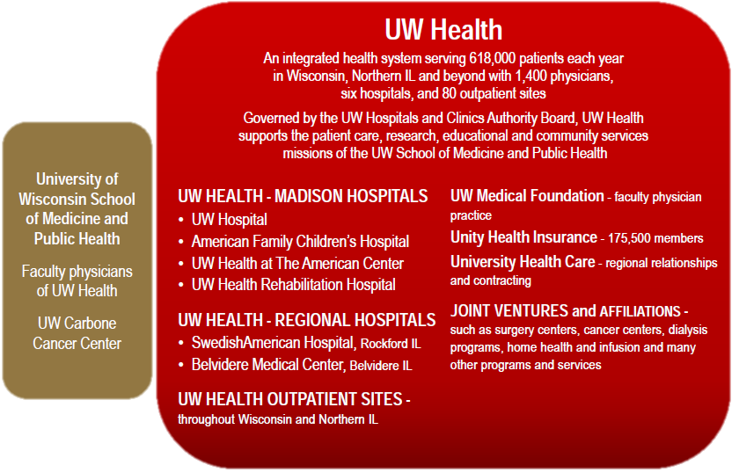
The UW Health Enterprise
5
Notes:
ACO Population management Unity Health Plan over 160,000 enrollees over 20 counties in SE WI

Slide 6
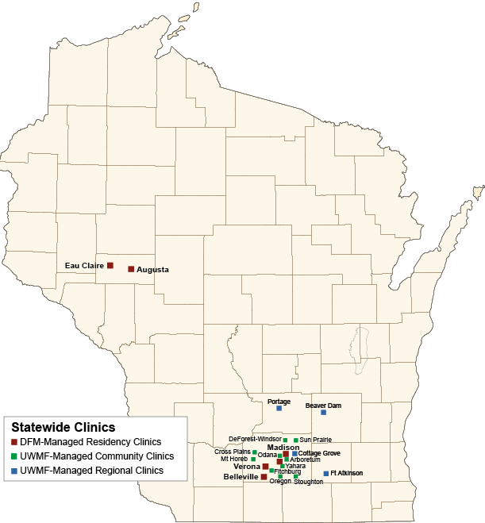
UW Health Primary Care
6
43 Primary Care Clinics in 32 locations
365 primary care clinicians
287,000 active patients medically homed at UW Health
Notes:
This includes GIM and peds
½ are family medicine homed

Slide 7
Primary Care Clinical Job Description
7
Maintain a weighted panel size of 1,800-2,200
Disease registries
Preventative health care
Population Management
40-50 hours total office time
30-32 minimum patient contact hours per week
Physical presence in clinic from 8:00-5:00
Clinical Care
Clinic-level quality improvement projects
Work in teams with Advanced Practice Provider
Notes:
Weighting was .55 the 22 year old male with insurance to the 2.22 45 year old female with medicare. Weighting was a 5 year process and defined by early 2012.. 3 FTE of physicians to 1.0 FTE of APP

Slide 8
Compensation Plan Evolution
8
Original Compensation Plan (100% RVU)
Compensation based on individual RVU’s
Physician in control of own salary
New Primary Care Compensation Plan
Compensation based on both clinic and individual level metrics (panel size, RVUs, quality metrics)
Notes:
Michelle

Slide 9
Details of UW Primary Care Plan
9
Fiscal year | Blended Benchmark Salary for FM (MGMA, AMGA, McGladrey&Pullen)
2015 | $220,961
2016 | $223,862
2017 | $225,127
2018 | $233,341
2019 | $239,886
  Compensation pool = Benchmark salary/1800 target panel size ($133.27 per patient for 2019) x panel size at the site (or group of sites)
  =

Slide 10
Details of UW Primary Care Plan
10
Clinic Site Compensation Pool
50%-C or 80%-R
Panel
50%-C or 20%-R
Work Metric (RVUs)
All medically homed patients at a single clinic site or several sites pooled
C = Community
R = Residency

Slide 11
Residency Faculty Clinical Compensation
Community Faculty Clinical Compensation
National benchmark
family medicine salary
Target panel size
×
Total panel size for all residency clinics
Residency Compensation Pool
= $3,911,111
National benchmark
family medicine salary
Target panel size
×
Individual clinic panel size
Community Compensation Pool
= $855,556
$220,000
1,800 patients
32,000 patients across 4 clinics
$220,000
1,800 patients
7,000 patients at clinic
80% panel-based
compensation
Individual clinical FTE*
Total clinical FTE for
all residency faculty
20% RVU-based compensation
Individual RVU productivity
Total RVU productivity for all residency faculty
Total clinical compensation for residency physician with 0.6 clinical FTE
= $133,629
50% panel-based
compensation
Individual panel size
Total panel size at clinic
50% RVU-based compensation
Individual RVU productivity
Total RVU productivity at clinic
Total compensation for community physician with 1.0 FTE and a panel size of 2,000 patients
= $217,284
0.5 FTE patient care +
0.1 FTE precepting
18 FTE
across 4 clinics
×
80% of compensation pool
3,000 personal RVUs
80,000 RVUs across 4 clinics
×
20% of compensation pool
2,000 patients
7,000 patients
at clinic
×
50% of compensation pool
4,000 personal RVUs
18,000 RVUs
at clinic
×
50% of compensation pool
Notes:
FTE=Full-Time Equivalent; RVU=Relative Value Unit
* Individual clinical FTE is composed of direct patient care and resident precepting, and was defined as 27 hours in clinic each week and 13 hours providing non face-to-face care.

Slide 12
Additional details of UW Primary Care Compensation Plan
12
5% of clinical comp is at risk if clinical job description is not met
  Meeting attendance
  Chart completion
  Participation in QI projects, teaching
Physicians can receive a 5% incentive bonus for meeting defined quality metrics
  Preventive care (e.g. breast cancer screening, vaccines)
  Chronic disease management (e.g. hypertension)
  Patient satisfaction (Press Ganey survey)

Slide 13
Panel Weighting System - 2013
13
Derived from 3 years of historical UW Health utilization data at PCP sites
Age
Insurance Type
Gender
Weightings range from 0.53 - 2.22
Normalized Peds, FM, GIM
Panels reflect office visit work done per patient

Slide 14
Successes
Physicians report improved satisfaction with amount and methodology of compensation, appreciate getting off of the “RVU” treadmill

Slide 15
Areas that have been changed over time
Panel weighting – of huge import when the weighted panel size is the key driver of compensation – goal is to weight based on predicted work in the PC office
  Reassess our weighting every year, 1 year look-back
  Accurate counting of the youngest age groups
  Including non face to face encounters when counting the “work” of primary care – increasing phone and electronic messaging
  Using RVU’s instead of # of office visits

Slide 16
UW Health Keys to Success
16
365 PCP’s
287,000 medically homed lives
Own HMO, 47% capitated business
Transparent Data
Weighted panel reports for PCP’s

Slide 17
Departmental keys to success
An active Primary Care Compensation Governance Group with senior and junior representation from all three primary care departments
Each department was given some autonomy within the overall framework to craft a plan meeting its needs

Slide 18
Keys to Successful Transition
18
Administration
Clinicians
Stakeholder buy in
  Align work with compensation, recruitment, quality, access
Design based on your goals
Set a clear time frame
Make measures meaningful and transparent
High quality data analytics team

Slide 19
Implementation Lessons
19
Need for institutional support
Need to continue to show value to the organization
Need to decide whether to align with Primary Care Specialties
Need to over-communicate at all levels
Organizational level issues
Notes:
Passion needs to be there

Slide 20
Implementation Lessons
20
Financial winners and losers in any new plan
Build measurement tools to help enforce minimum clinical standards and to report quality data
Division level issues

Slide 21
Unintended Consequences of New Comp Plan
21
Revert to meeting minimum job standards
Increased policing with regard to meeting minimum standards
Decreased patient visits and RVU’s are difficult to explain in light of increased cost of comp plan
Change in roles of clinic staff/staffing models
  Difficult to justify levels with decreased patient visits
  Need to modify roles as part of team approach
Notes:
How will your organization respond. Checking hours.

Slide 22
Ongoing Issues
22
Changing national landscape
Refining how to measure work
Panel size, RVUs, Template hours, Quality?
Being available in clinic is important with focus on managing patient panels and team care
Previous culture of individual flexibility in RVU model has changed
Each doc in the clinic impacts the salary of the other docs in the clinic
Changing culture of physicians to team-based care
Notes:
MA, RN roles being elevated. Cultural change. We are continueing to study it. Primary care through UW Health became the golden children, We have higher physician expectations and with that accountablity.

Slide 23


Questions?
23
?
?
?
?
?
?
?
?
?
Notes:
What is your current clinical comp plan?
How do you measure work?
Population based component
RVU’s
Ensuring work equity
How do you measure quality?
Could you integrate or adapt any of UW’s plan in your own setting?
Implementation successes or failures
Consequences of moving away from production based (RVU) comp
Physician culture change
Compensation
Population Health Care

Slide 24
References
Kamnetz S, Trowbridge E, Lochner J, Koslov S, Pandhi N. A simple framework for weighting panels across primary care disciplines: findings from a large US. multidisciplinary group practice. Quality Management in Healthcare. 2018;27(4):185-190.
Lochner J, Trowbridge E, Kamnetz S, Pandhi, N. Family physician clinical compensation in an academic environment: moving away from the relative value unit. Fam Med 2016;48(6):459-466.

Slide 25
Thank You!
25
Contact Information:
Jennifer Lochner
jennifer.lochner@fammed.wisc.edu
608-424-3384
Sandy Kamnetz
sandra.kamnetz@uwmf.wisc.edu
608-262-3171

