Slide 1
Partnering with Programs to Create a Culture of Competency-based Medical Education in Family Medicine
February 7, 2024
Linda Montgomery, MD, Chair STFM CBME Task Force
Sarah Cole, DO, President-Elect AFMRD

Slide 2
By the end of this session you will be able to:
Articulate the “Why of CBME” in GME and especially Family Medicine
Describe the new ACGME and ABFM CBME-related requirements
Recommend resources to your programs
Identify key ways you can help in the transition to CBME
Notes:
Linda - Very general definition of CBME and why this change now - Linda

Slide 3
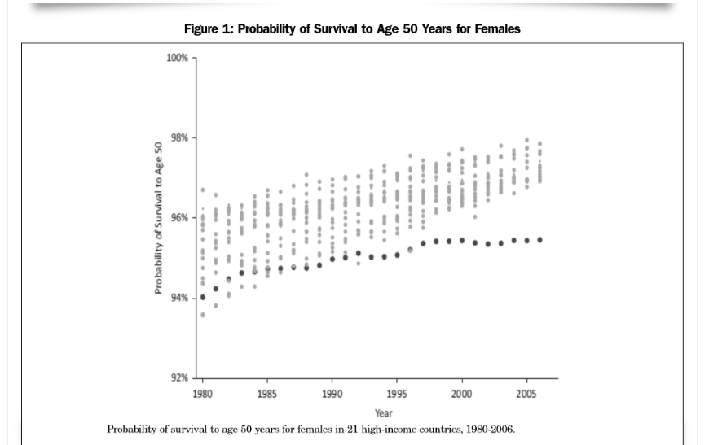
Why Competency-Based Medical Education?
“Despite ubiquitous rhetoric of ‘innovation and transformation,’ the outcomes of health care in the United States are getting worse, with declining life expectancy, worse outcomes across all ages and most diseases and…health disparities,”
Newton W, Cagno CK, Hoekzema GS and Edje L. Core Outcomes of Residency Training 2022 (Provisional). Ann Fam Med. 2023;21(2):191-194

Slide 4
Notes:
So a CBME framework allows us to determine what our outcomes of training should be to meet societal needs AND it gives us the flexibility to define the training to reach those outcomes. The goal of CBME is to ensure that all learners achieve the desired patient-centered outcomes during their training.

Slide 6
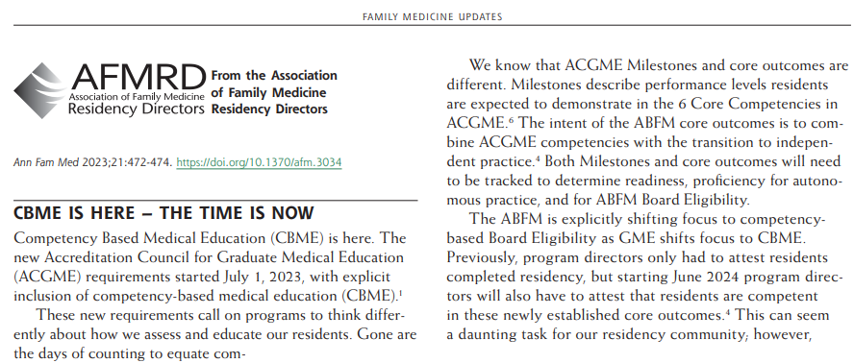
Why is CBME especially needed in Family Medicine?
“CBME explicitly places the patient, family, and community at the center of training with the primary goals of concomitantly improving both educational and clinical outcomes.”
Notes:
Competency-based medical education has been important across all ACGME programs in all disciplines as a way to ensure quality and safety to the public. Tom Nasca, the ACGME President has been a large proponent of CBME. But why is this model especially important and good for FM? It has allowed us to explicitly state the outcomes we want to create and allows the flexibility to work within our curriculum to build the experiences to reach that outcome.

Slide 7
How are CBME principles showing up in the new ACGME Requirements for GME in FM?
Notes:
Using the framework of the six ACGME core competencies, the new requirements for GME in FM devote EIGHT pages to a detailed description of the knowledge, skills, and attitudes in which a program’s resident must demonstrate competence.

Slide 8
Competency language replaces things like patient volumes and rotation numbers
Notes:
AND each piece of the curriculum is defined now according to competence and experiences rather than with things like patient volumes and rotation lengths– Let’s look at an example with NB --

Slide 9
Old Program Requirements: NB Care

Slide 10
Notes:
There are no patient numbers defined here. Residencies must provide an experience in care of well and ill newborns and then have an assessment structure to attest to competence.

Slide 11
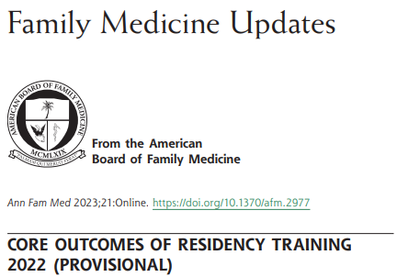
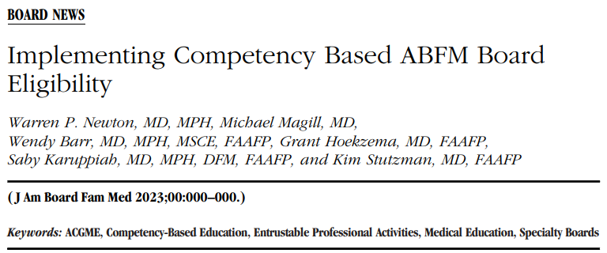
Notes:
In addition to the competency language of the ACGME PRs for GME in FM, in March 2023, the Accreditation Council for Graduate Medical Education (ACGME) Review Committee for Family Medicine (RCFM) and American Board of Family Medicine (ABFM) jointly proposed 12 core competencies for family medicine residency training.

Slide 12
Readiness and Board Eligibility
40 weeks of continuity clinic per year
1000 hours of continuity care
PDs attest to “readiness for autonomous practice” - using Outcomes

Slide 13
Outcomes (Formally known as EPAs)
6 Competencies
Sub-competencies
Milestones
Outcomes
Notes:
Required by ABFM THIS YEAR
Like EPAs, Outcomes describe the essential work for autonomous practice. Nobody was using the EPAs
Milestones and competencies describe the attributes of the learner and the essential skills needed to get to the outcomes
Milestones focus on ACGME core competencies and allow consideration of how residents develop, whereas the core outcomes combine multiple ACGME competencies and underscore the transition to independent practice.

Slide 14
The ABFM Core Outcomes and Attestation Roll Out
2024 | Practice as personal physicians, providing first contact, comprehensive and continuity care, to include excellent doctor-patient relationships, excellent care of chronic disease and routine preventive care and effective practice management Diagnose and manage acute illness and injury for people of all ages in the emergency department or hospital Provide comprehensive care of children, including diagnosis and management of the acutely ill child and routine preventive care Develop effective communication and constructive relationships with patients, clinical teams, and consultants Model professionalism and be trustworthy for patients, peers, and communities
2025 | Practice as personal physicians, to include care of women, the elderly, and patients at the end of life, with excellent rate of continuity and appropriate referrals Provide care for low-risk patients who are pregnant, including management of early pregnancy, medical problems during pregnancy, prenatal care, postpartum care and breastfeeding, with or without competence in labor and delivery Diagnose and manage common mental health problems in people of all ages Perform the procedures most frequently needed by patients in continuity and hospital practices Model lifelong learning and engage in self reflection
2026 | Practice as personal physicians, to include musculoskeletal health, appropriate medication use and coordination of care by helping patients navigate a complex health system Provide preventive care that improves wellness, modifies risk factors for illness and injury, and detects illness in early, treatable, stages for people of all ages while supporting patients’ values and preferences Assess priorities of care for individual patients across the continuum of care—in-office visits, emergency, hospital, and other settings, balancing the preferences of patients and medical priorities Evaluate, diagnose, and manage patients with undifferentiated symptoms, chronic medical conditions, and multiple comorbidities Effectively lead, manage, and participate in teams that provide care and improve outcomes for the diverse populations and communities they serve
Notes:
The ABFM subsequently announced in June 2023 that it will require family medicine program directors to sequentially attest their graduating residents are competent in 15 outcomes that are based on the 12 core competencies. Those 15 core outcomes are being gradually rolled out over 3 years. PDs will need to attest to the first 5 for the class of 2024, the first 10 for the class of 2025, and all 15 for the class of 2026 and subsequent classes. We appreciate that both the RCFM and the ABFM engaged in dialogue with the community of family medicine program directors (PDs) to inform their defined competencies, outcomes, and schedule of attestations.

Slide 15
ABFM Core Outcomes (June 2024)
Practice as personal physicians, providing first contact, comprehensive and continuity care, to include excellent doctor-patient relationships, excellent care of chronic disease and routine preventive care and effective practice management
Diagnose and manage acute illness and injury for people of all ages in the emergency department or hospital
Provide comprehensive care of children, including diagnosis and management of the acutely ill child and routine preventive care
Develop effective communication and constructive relationships with patients, clinical teams, and consultants
Model professionalism and be trustworthy for patients, peers, and communities
Notes:
These are the five core outcomes that your PD have been (or are about to) focus on attesting to for the class of 2024. They center a resident’s ability to serve as a personal physician, care for acute illness & injury, care for children, communicate effectively, and to demonstrate professionalism and trustworthiness.

Slide 16
Basic steps to implement CBME
Early Engagement
Develop Infrastructure
Sustain
Culture
Develop a plan to assess each outcome
Map curriculum & rotations to outcomes
Train instructor/learner champions & academic advisors
Determine where direct observation is needed
Field-test direct observation & assessment tools
Evaluate the design & implementation of the process
Notes:
The question facing PDs, thus, is “As the person from the program who is attesting a resident is competent in these outcomes, how am I specifically going to know they are? As I pledge this to the public, how am I going to feel confident in their competence?” Thus, in 2023-24 PDs have found themselves engaged in CBME implementation. Different PDs may be at different phases of implementation. Some of us may be in early engagement. Others may be engaged and actively working to develop infrastrucure within the program to document

Slide 17
Tools for the Big Lift
Notes:
So, there’s lots of ongoing work for the faculty development and other resources.

Slide 18
ABFM Foundation Grants to STFM
Phase 1: August 2021 – December 2023
Phase 2: September 2023 – August 2025
Summit to get input
Task force to develop action plan
Update existing STFM faculty development resources
Mobile app for direct observation
Faculty development resources
CBME STFM Collaborative creation
Pilot project
$185,808
Notes:
Objective: Support family medicine residency programs in their transition to competency-based medical education

Slide 19
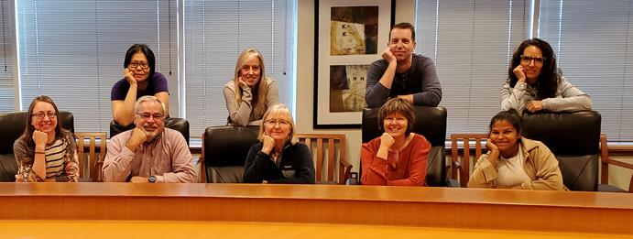
The STFM CBME Task Force has been working hard to figure out and make resources relevant for programs…

Slide 20
stfm.org/cbmetoolkit

Slide 21
Notes:
Created an online toolkit to house the resources and opportunities that have been developed.

Slide 22
Getting Started: CBME One Pagers
CBME: What is It and Why Now?
Creating Competency-Based Goals and Objectives
Tips for Implementing Individualized Learning Plans
Coaching in Residency Education: Guiding the Resident Toward Core Outcomes
Best Practice Recommendations for Utilizing the Core Outcome Mapping Project
What is a Master Adaptive Learner and Why is This Important to Resident Engagement
Notes:
These are available in the toolkit. We continue to add to these.

Slide 23
Faculty Development Webinars
What You Need to Know About ACGME and ABFM Expectations for a Shift to Competency-Based Medical Education
Reflections, Goals, & Objectives – Oh My! Best Practices for Creating ILPs
Let’s Talk About Entrustment
Assessment Tools for CBME and the Core Outcomes
Building CBME Into Faculty Development
Advisors and Coaches: The Evolving Role of Faculty and Resident Relationships
How to Have Reflective Feedback Conversations and Develop a Culture of Effective Feedback
Fostering Master Adaptive Learning and a Growth Mindset in Your Program
How to Effectively Use Electives to Help Residents Attain Competency in the Core Outcomes
The Role of Resident Portfolios in Competency-Based Assessment
Managing Assessment Burden in CBME
stfm.org/cbmewebinars
Notes:
Planned a series of CBME webinars. These are co-branded and co-marketed with AFMRD. We have more than 500 people registered for the first webinar, which will take place this Friday. Each webinar has at least one member of the task force. We’ve also included presenters from an open call we put out for CBME subject matter experts.

Slide 24
In Person Faculty Development Opportunities
AAFP Residency Leadership Summit
STFM Annual Spring Conference
National Conference of Residents and Medical Students
Faculty Development Delivered
Notes:
They’ve planned in-person faculty development. We submitted a request and objectives for faculty development delivered workshops. That was accepted and we’ve identified faculty for that.
We submitted several abstracts for the AAFP Residency Leadership Summit. There are 10 sessions on that conference schedule that are related to CBME. Some were submitted by the task force; some were submitted by others. The opening session will be by Stacy Potts who was formerly part of the ACGME FM-RC. There will be sessions at the STFM Annual Spring Conference.
Based off one of our submissions, some of the task force members was asked to create an on-demand course for AAFP. That will be released later this year.
And Linda Montgomery and I have a meeting in the next couple of weeks with representatives of the ACGME to talk about potentially being an ACGME hub. There are some STFM members in NC who are forming a hub, and I talked to them recently. It’s still unclear to me exactly what a hub is and what support the ACGME provides to hubs, so I’m hoping that will become clearer on the call.

Slide 25
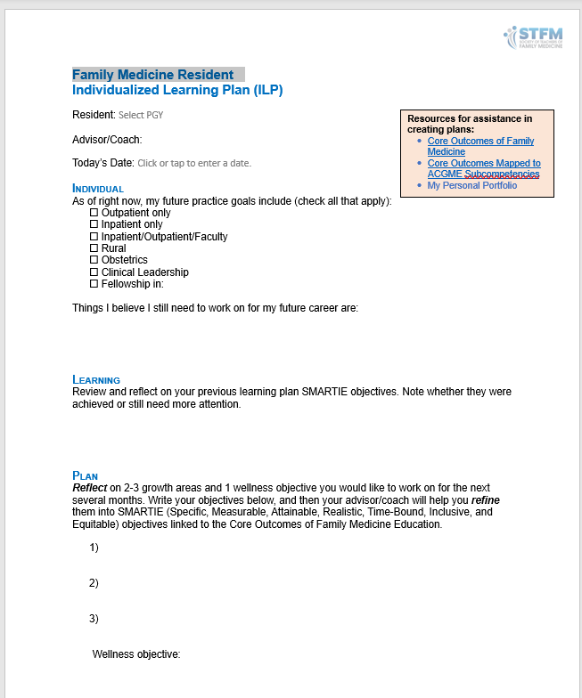
ILP Template

Slide 26
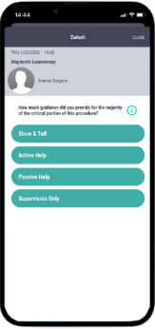
Coming soon…
Direct Observation CBME App
National Recommendation for Implementation of CBME in FM
Menu of Assessment Tools for Outcomes Attestation
(2024/2025/2026)
Pilot Project
Faculty and staff from up to 25 residency programs
Implement the mobile app, the STFM individualized learning plan, other assessments and strategies
IRB-approved study of the effectiveness of the training and resources

Slide 27
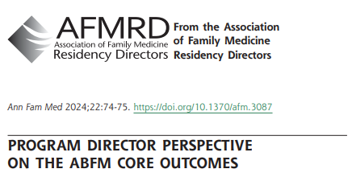
AFMRD Tools to Support PDs
“PDs can leverage their CCCs and PECs to ensure they have comprehensive data to support their public attestation of graduating residents’ competency.”
Notes:
Again, the crux of the matter for PDs is that their name is on the line for this. To feel confident in their attestation, we can engage with our clinical competency committees (CCCs) to optimize the assessment of individual residents within our programs. CCCs can identify the methods and areas in which they currently assess residents then align them to ACGME Milestones 2.0 for use during CCC reviews and to ABFM core outcomes. We can evaluate the list for gaps and create (or ask the CCC or faculty to create) assessments that align with core outcomes that are not currently being assessed well. In many cases, we can use existing resources (
While attesting to outcomes requires us to focus on an individual resident, it also affords the opportunity to review our program, curriculum, and structure. The program evaluation committee (PEC) can review milestone data and outcomes in aggregate in order to craft changes to our programs that will assure residents can be successful.

Slide 28
AFMRD Tools to Support PDs
Webinar to model the attestation process (spring 2024)
One-pager on:
ABFM Core Outcome Attestation: a How-to Guide (spring 2024)
Strengthening Outcomes and Assessment in Residency
co-sponsored with ABFM

Slide 29
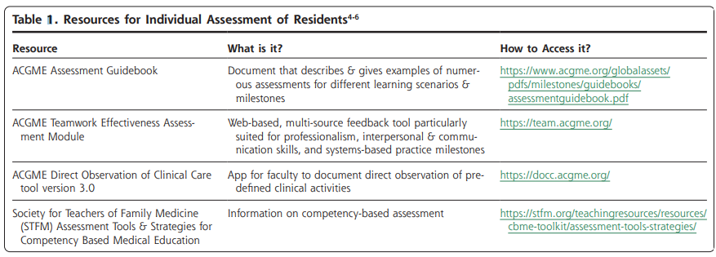
Additional Tools to Support PDs

Slide 30
How might ADFM members support and encourage CBME in GME-FM?

Slide 31
Mobilization of Resources
Time
Tools & Technology
Training
Relationships

Slide 32
Time for Program Leaders and Faculty
Early engagement & develop infrastructure
Sustain culture
Map curriculum to assessment plan to competencies
Revise existing or create new assessment tools
Develop faculty, staff and residents (annually)
Faculty will routinely need more time for direct observation and assessment
Advisors will routinely need more time to process and relay results to residents

Slide 33
Tools and Technology
Assessment tools (paper, web-based, mobile, other)
Learning management systems
Residency management systems
Learning specialists/coaches for ILPs and/or for learners not meeting expectations
Remediation resources

Slide 34
Training
Professional development for faculty, residents, students and staff
Professional development for other specialties
Anti-bias training
Access to outside courses/resources
ACGME CBME course

Slide 35
Relationships
FM Dept Chair
Other Dept Chairs or PDs
DIO
FM PD
Dean’s Office
Other leaders
Notes:
Especially helpful with bridging to other depts who are teaching and assessing FM AND to med schools to bridge the UME to GME transition
What can medical schools be doing to foster a growth mindset? To help them move away from grade-based to competency-based education in time to be day 1 ready for CBME in GME? Is there a way to develop UME Milestones that can be harmonized into specialty, esp FM specialty, Milestones

Slide 36
Key Points
PDs want to apply a thoughtful, comprehensive approach to CBME within their programs so they confidently attest to the ABFM that their residents have achieved core outcomes.
The support and encouragement of their Dept Chair is critical to these efforts and we thank you!
Please help your PD by setting clear expectations for CBME implementation so residents and faculty do not look backward!
Notes:
May have budgetary implications

Slide 37
Thoughts and Questions?

Slide 38
References
Newton W, Cagno CK, Hoekzema GS and Edje L. Core Outcomes of Residency Training 2022 (Provisional). Ann Fam Med. 2023;21(2):191-194
American Association of Medical Colleges. (n. d.). Competency-based medical education. https://www.aamc.org/about-us/mission-areas/medical-education/cbme#:~:text=One%20of%20these%20changes%20is,uses%20competencies%20or%20observable%20abilities.
Holmboe, E. (2021). The transformational path ahead: competency-based medical education in family medicine. Family Medicine, 53(7), 583-589. https://10.22454/FamMed.2021.296914
Hsu, T., De Angelis, F., Al-Asaaed, S., Basi, S. K., Tomiak, A., Grenier, D., Hammad, N., Henning, J. W., Berry, S., Song, X., & Mukherjee, S. D. (2021). Ten ways to get a grip on designing and implementing a competency-based medical education training program. Canadian Medical Education Journal, 12(2), e81–e87. https://doi.org/10.36834/cmej.70723
Kelly, K., & Diaz, K. (2023). CBME is Here - The Time is Now. Annals of Family Medicine, 21(5), 472–474. https://doi.org/10.1370/afm.3034
Van Melle, E., Hall, A. K., Schumacher, D. J., Kinnear, B., Gruppen, L., Thoma, B. & ICBME Collaborators. (2021). Capturing outcomes of competency-based medical education: the call and the challenge. Medical Teacher, 43(7), 794-800. https://doi.org10.1080/0142159X.2021.1925640

